Slide 1

Mapp
Team 7
Laurence Pak Nin NG
Markian Hromiak
Sam Milner
Steven Nguyen
Todor Naydenov

Slide 2
Motivation
Hungry tourists

Slide 3

Motivation
Where can I find some food?

Slide 4
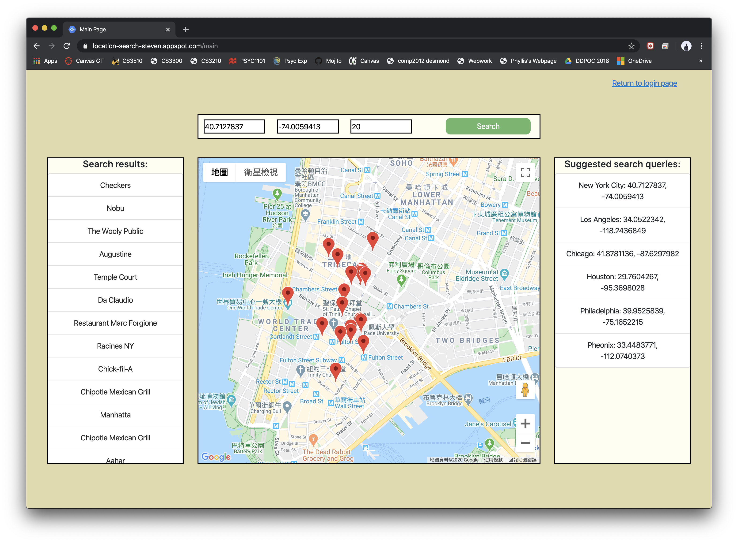
Here’s a solution:
Mapp
A restaurant
finding application

Slide 5
Software Development Methodology
Agile is used
Reason:
Flexible & malleable scheduling, fits teammates’ ever-changing schedules

Slide 6
Planning & Requirement Setting
In the one-week preparation sprint:
Defined requirements
Assigned roles to teammates
Created user stories
Set up GitHub repository
Began story assignments

Slide 7
Development & Testing
In 2 two-week development sprints:
Developed features based on stories
Test after each feature is developed
Mockito & JUnit for backend
Manual testing for frontend
Bugs reported on Slack, picked up by developer of corresponding feature

Slide 8
Shortcomings

Slide 9
Communication
Primary communication channel: Slack
Every Monday: Google Hangout meeting (1 hour)
Every Wednesday: Physical meeting (1 hour)
After every CS3300 class: stand-up meeting (10 minute)

Slide 10
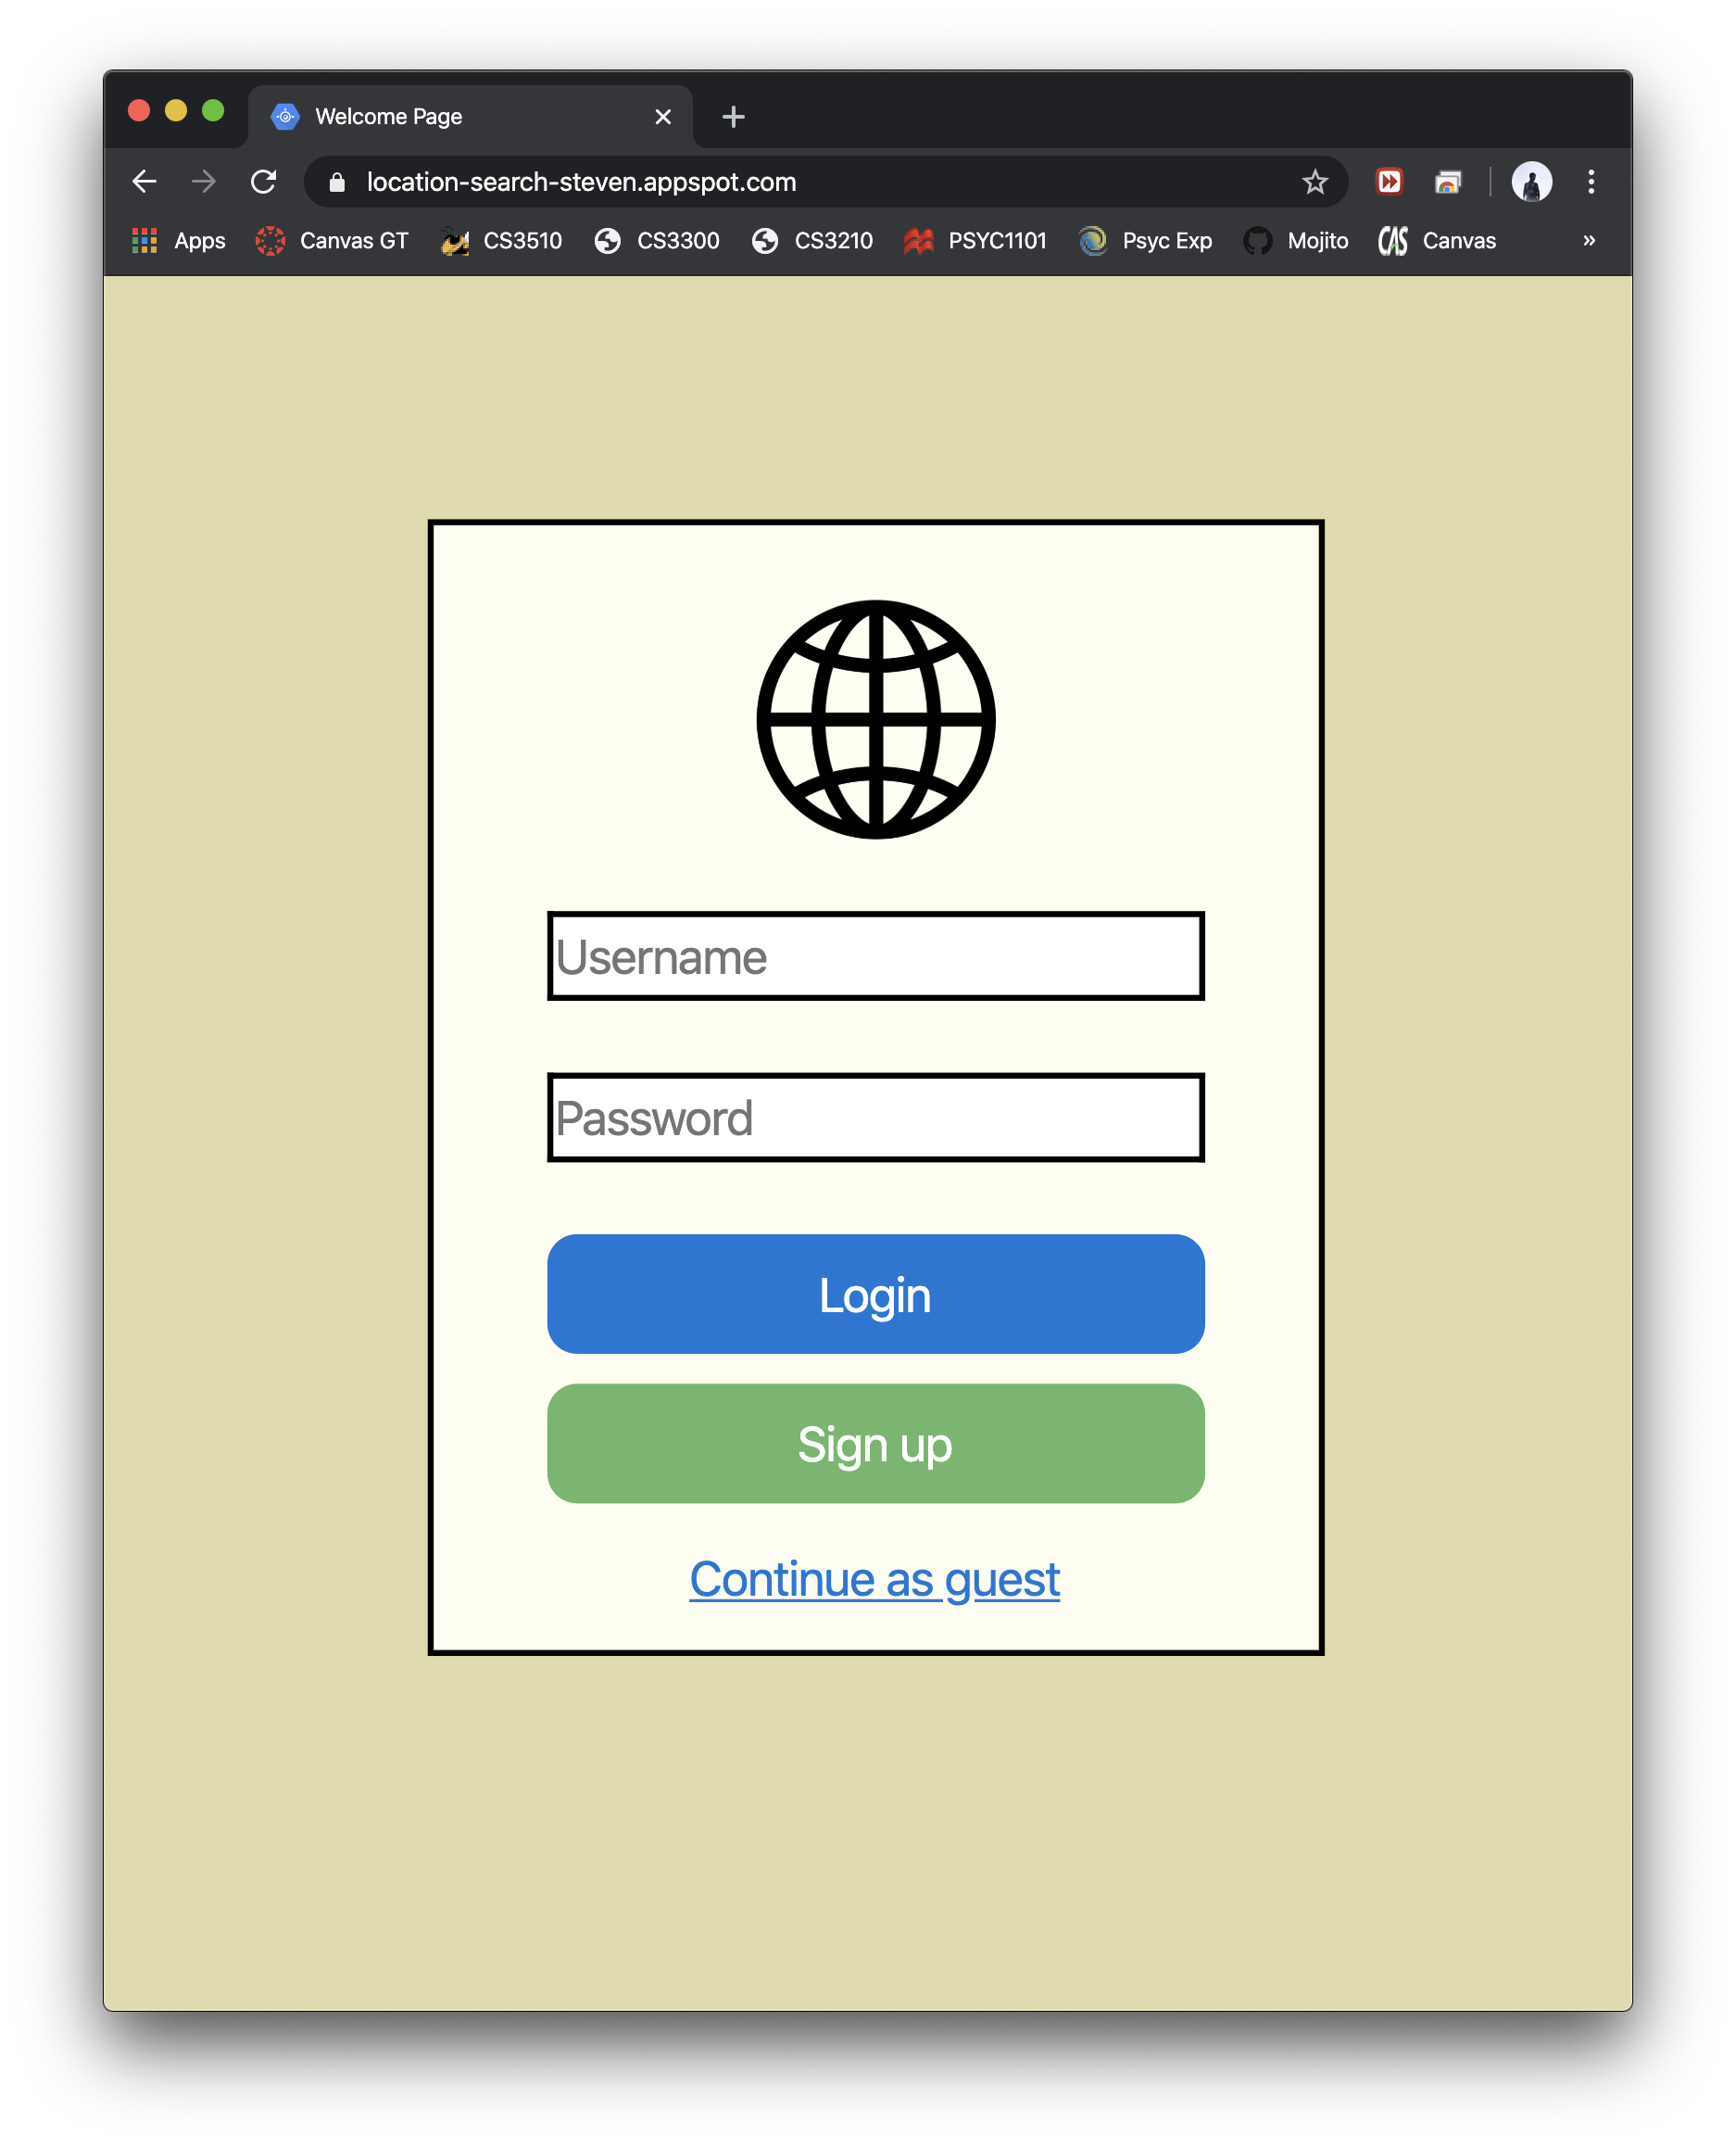
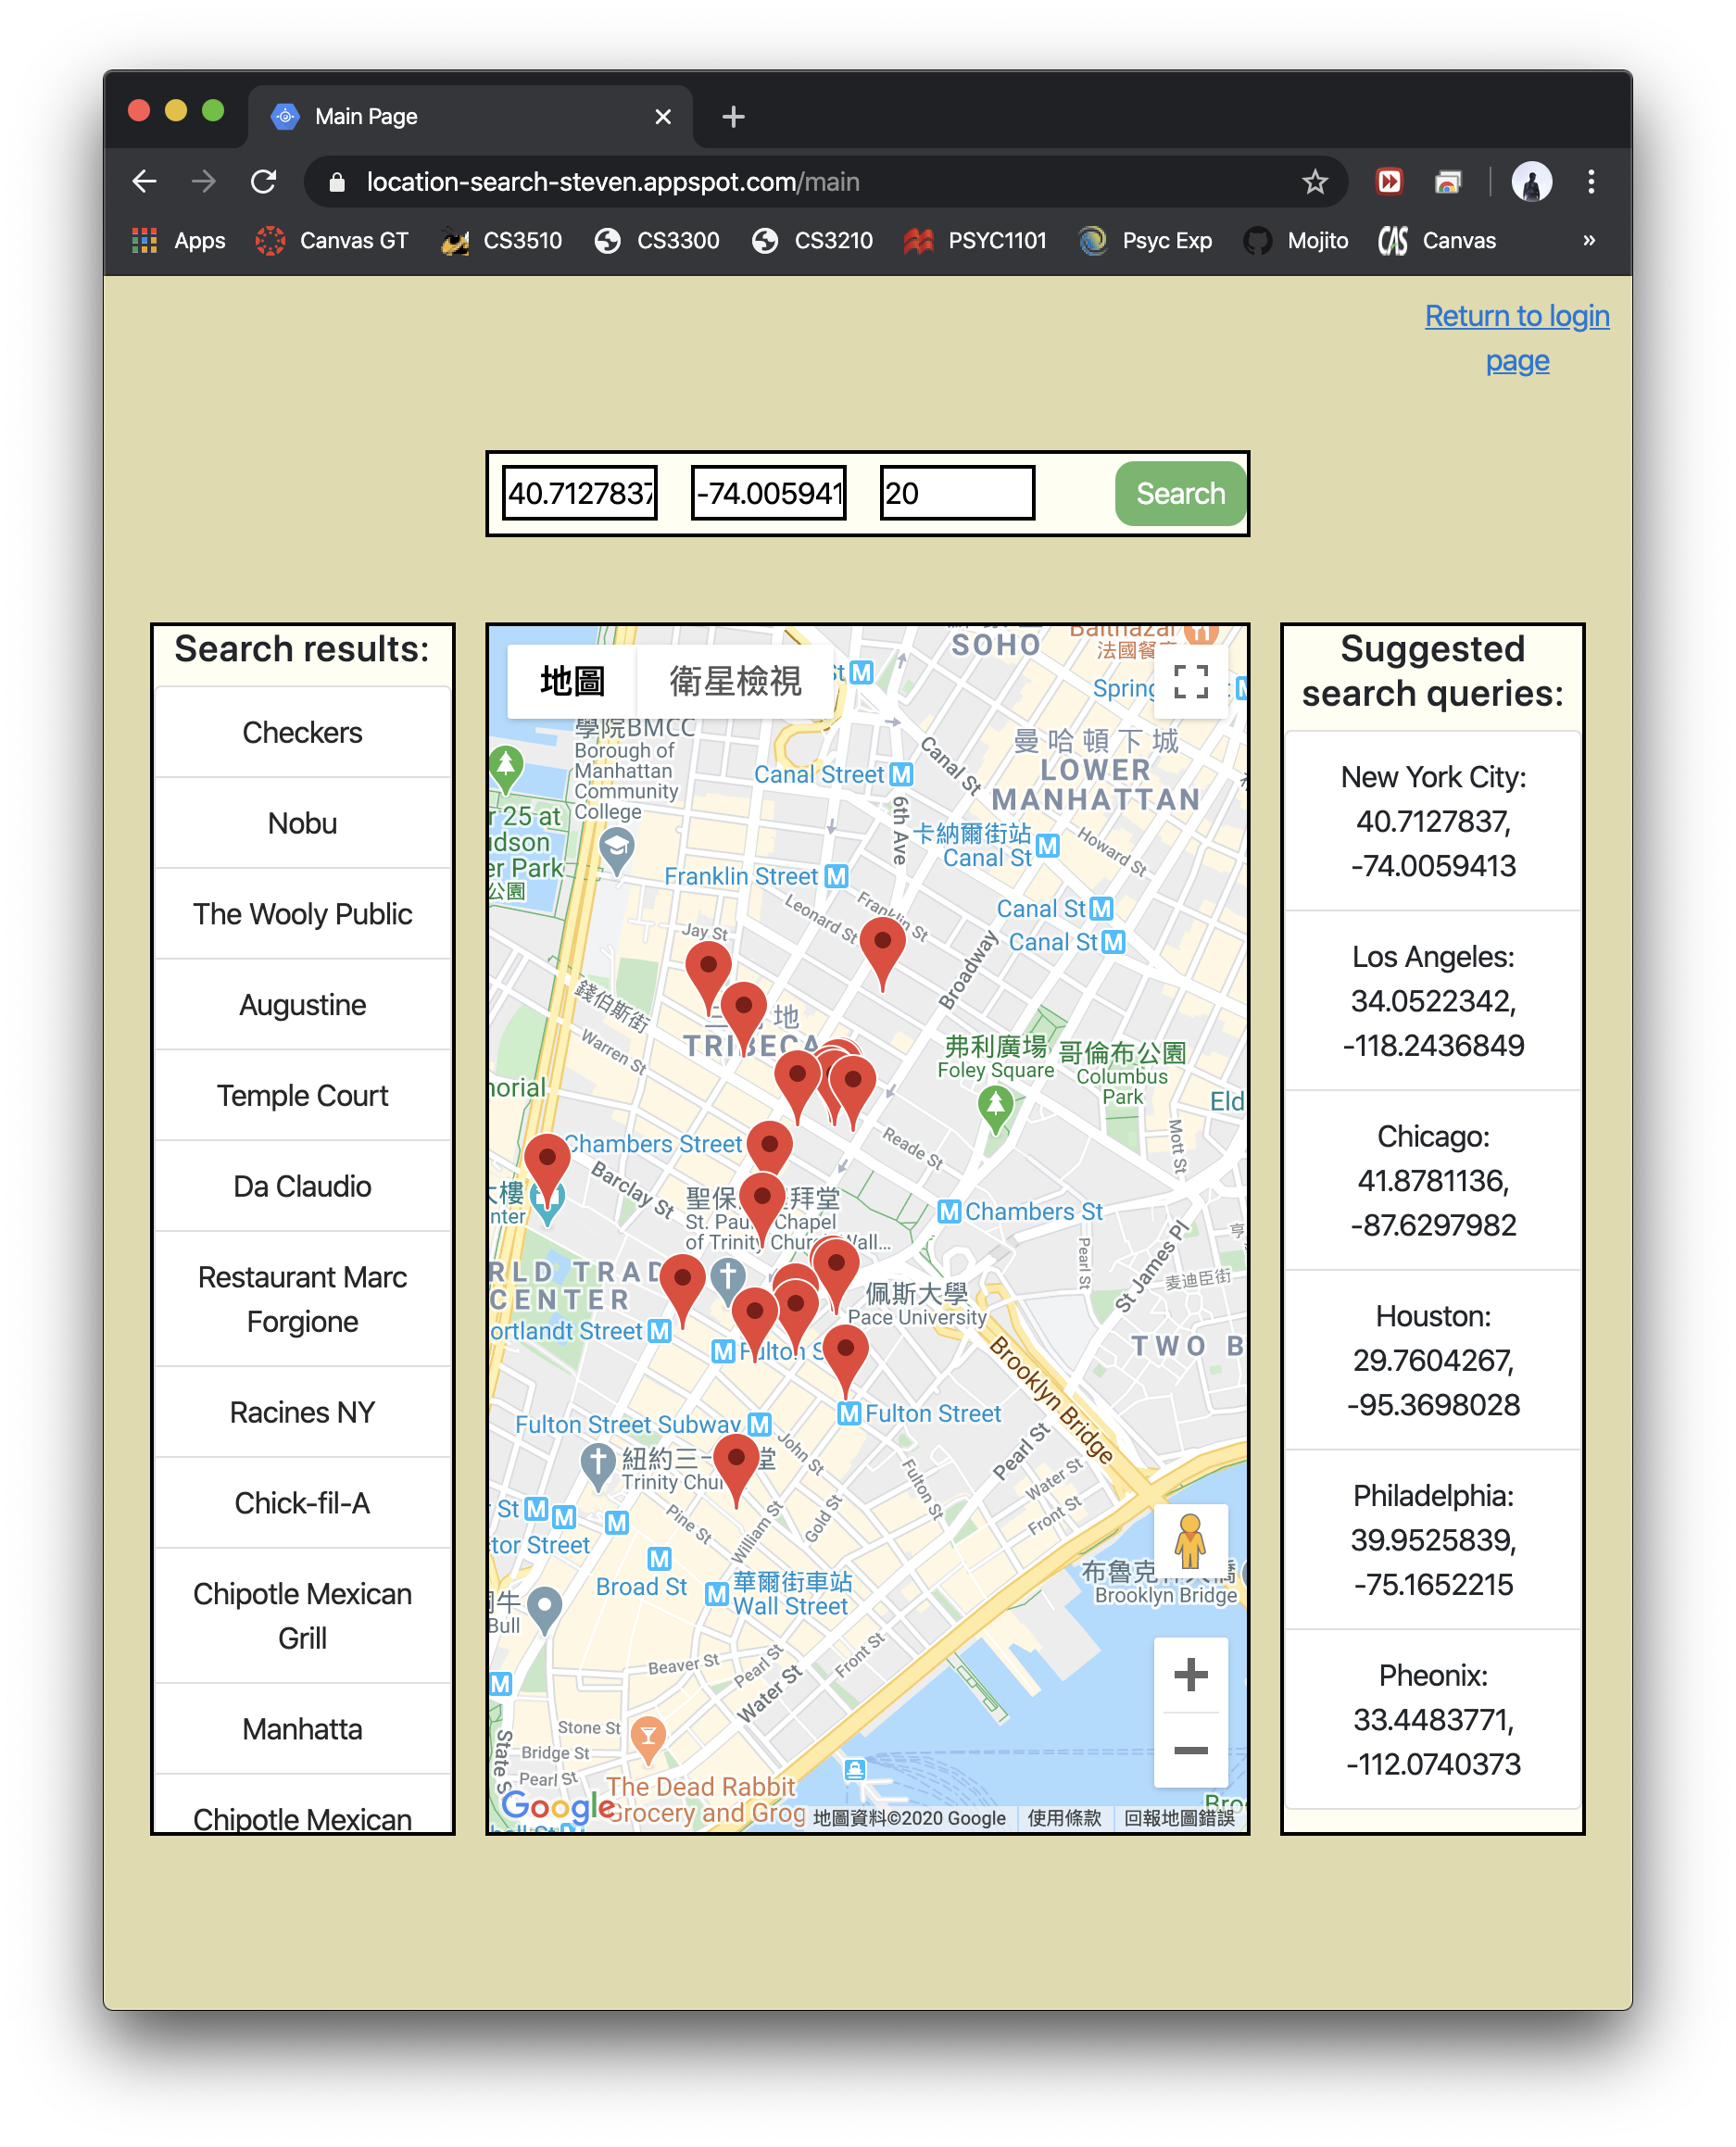
Technology Used
Firestore: user profile
Bcrypt: password hashing & salting
Google Map API: embedded map
Places API: restaurant serches
Google App Engine: hosting application

Slide 11
Live Demonstration
Here is the product we want to show you…

Slide 12
Q&A
Any questions?

